Slide 1
INTERN PROJECT
REAL TIME EMBEDDED CONTROLLERS AND IoT
PRESENTATION

Slide 2

OUR TEAM
1) MOHAN PRASATH S
2) NITHIYA GIRISHON K P
3) NITHIYANANTHAM M

Slide 3
Project Title:
SAFETY MEASURES ON
POWER WINDOWS

Slide 4
PROJECT DESCRIPTION
To develop a Real Time application to implement safety in the car. This project provides a variety of features and automation features in the car such features are Power windows like temperature monitoring in interior of the car. And Door open and Close monitoring, window open/close monitoring, It helps to indicate the user. And also automating the car and increase the safety features. In this project, we used Potentiometer instead of LM35 for monitoring temperature and IR sensor for detecting whether the door is closed or opened

Slide 5
BLOCK DIAGRAM
BUZZER
STM32F405RGT6
Microcontroller
SWITCH
IR
LCD DISPLAY
16X2
POTENTIOMETER
LED

Slide 6
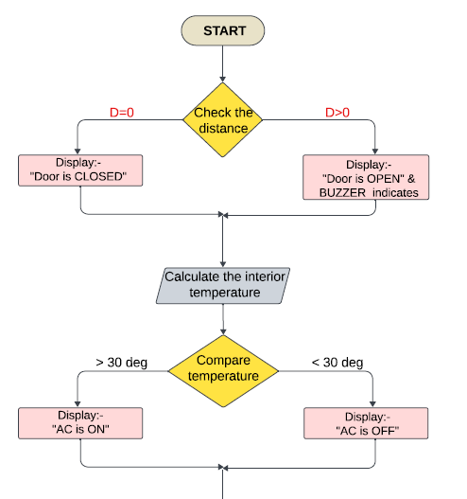
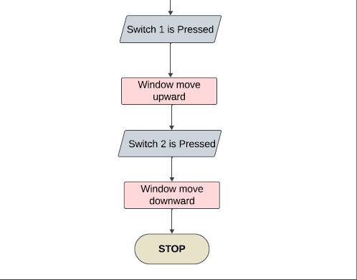
FLOWCHART

Slide 7
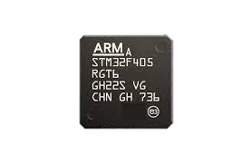
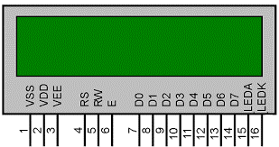
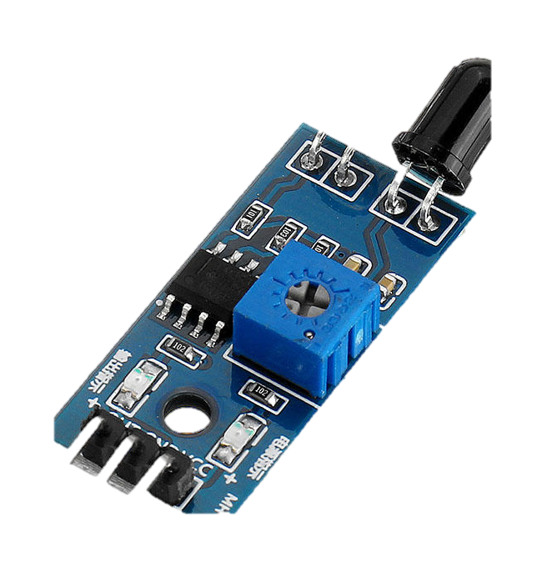
COMPONENTS USED
LCD DISPLAY 16X2
LED
BUZZER
SWITCH
IR
POTENTIOMETER

Slide 8
MAPPING
COMPONENTS | INPUT/OUTPUT | FUNCTION
IR SENSOR | INPUT | To check whether the door is closed or opened
LCD DISPLAY 16X2 | OUTPUT | To display the output
POTENTIOMETER | INPUT | To vary the temperature instead of using lm35
LED | OUTPUT | To check the window is opened or closed
SWITCH | INPUT | Used for closing and opening windows
BUZZER | OUTPUT | Indicates if door is opened

Slide 9
WORK FLOW
Initialize User defined function for LCD An ADC
Vary the potentiometer For Temperature, and IR
Update Data From Sensors.
Check whether the door is closed or opened and display the output.
If door is closed check the temperature and display whether the AC is turned ON or OFF
Turn on Led If Window is Closed
Turn Off Led If Window is Opened

Slide 10
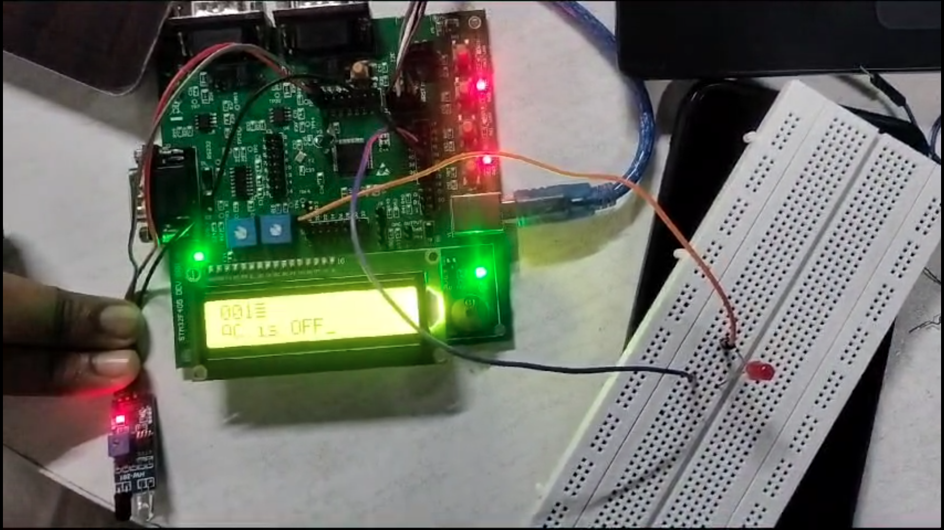
Demo

Slide 11
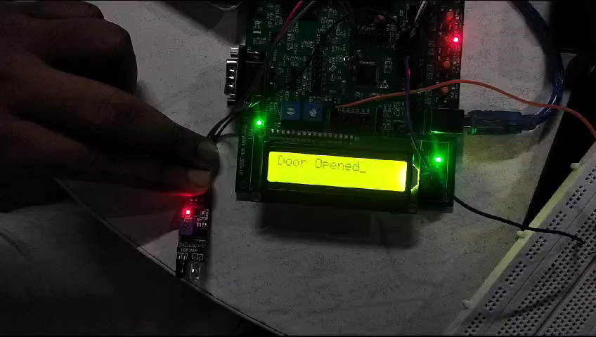
Demo

Slide 12
THANK
YOU

